Slide 1
Lecture 3:
Loss functions and Optimization

Slide 2
Administrative
A1 is due Jan 20 (Wednesday). ~9 days left
Warning: Jan 18 (Monday) is Holiday (no class/office hours)

Slide 3
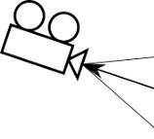

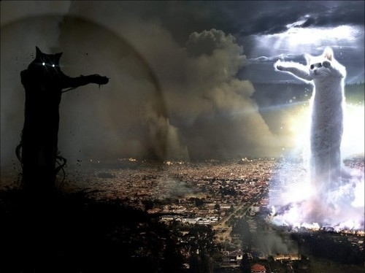
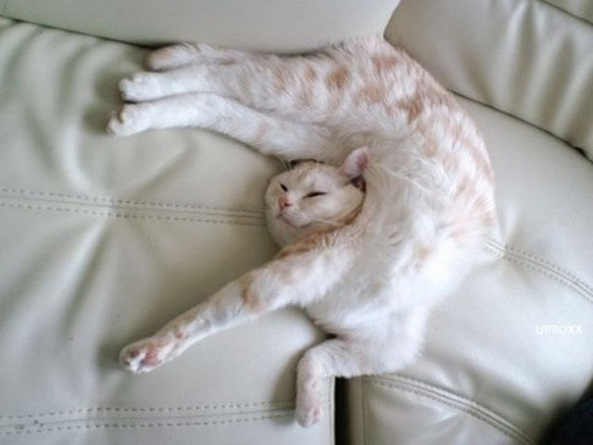
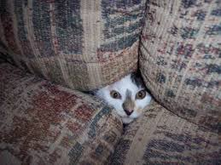
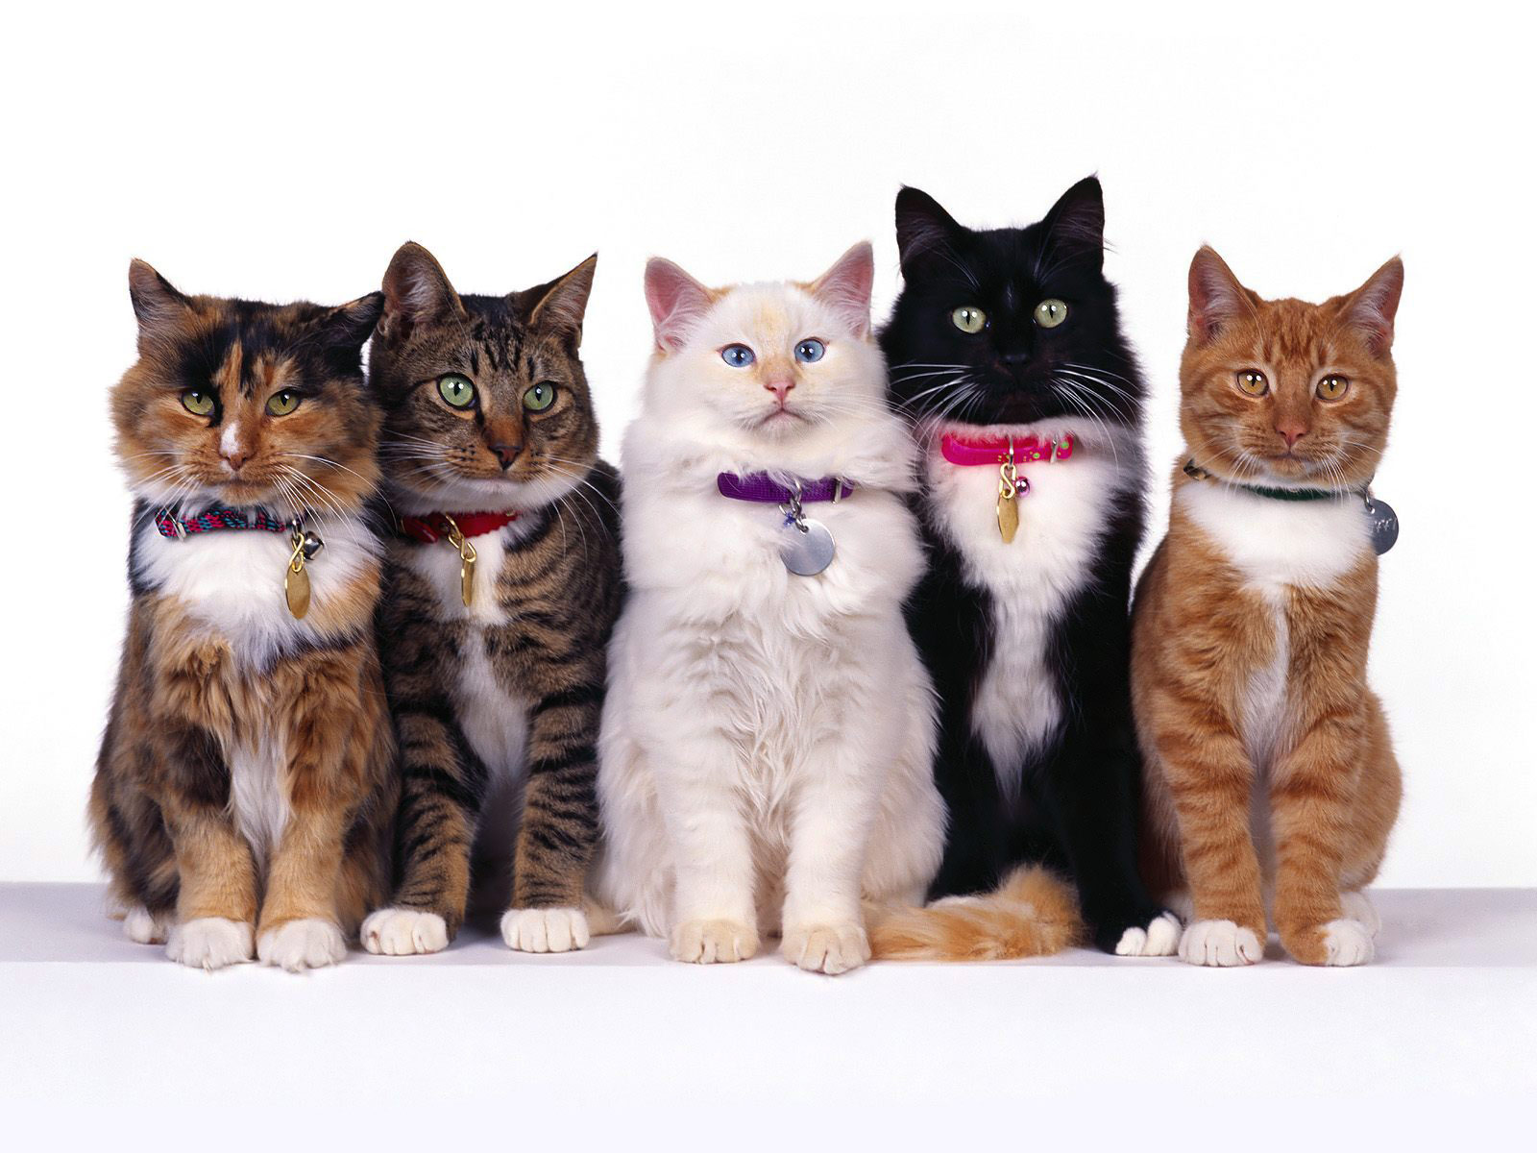
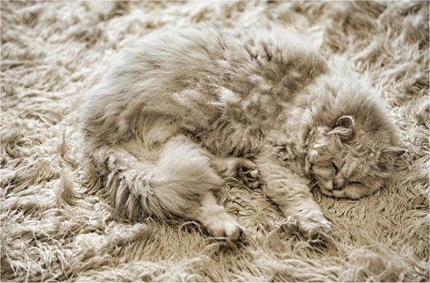
Recall from last time… Challenges in Visual Recognition
Camera pose
Illumination
Deformation
Occlusion
Background clutter
Intraclass variation

Slide 4
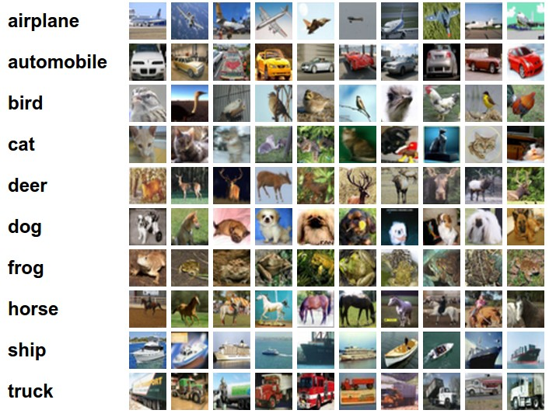
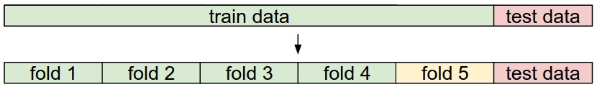
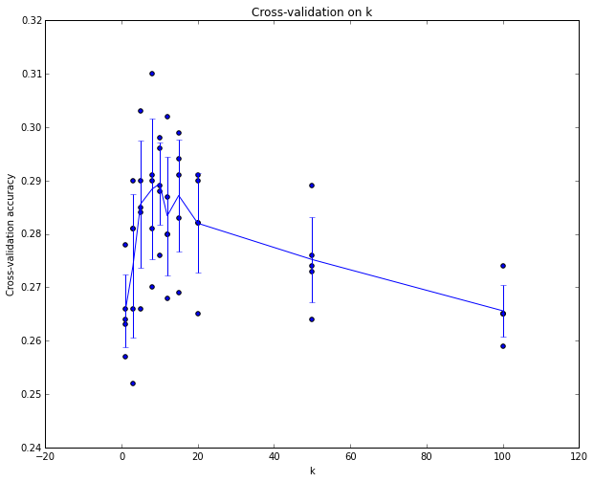
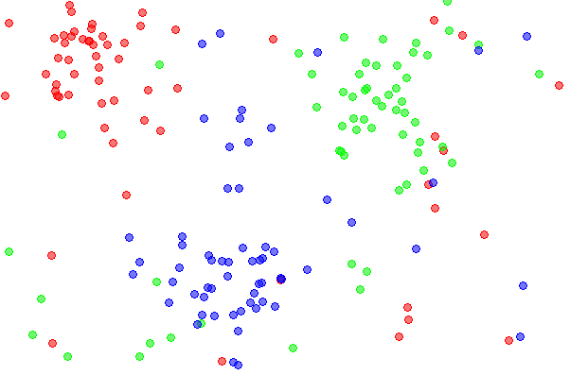
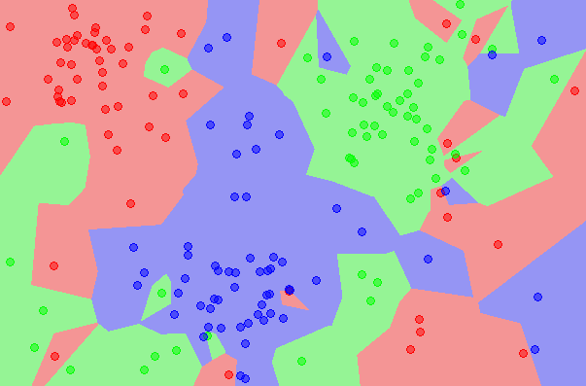
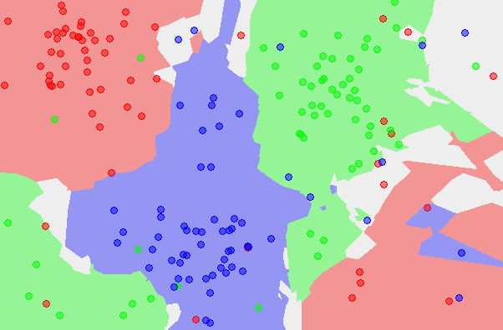
Recall from last time… data-driven approach, kNN
the data
NN classifier
5-NN classifier

Slide 5
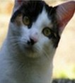
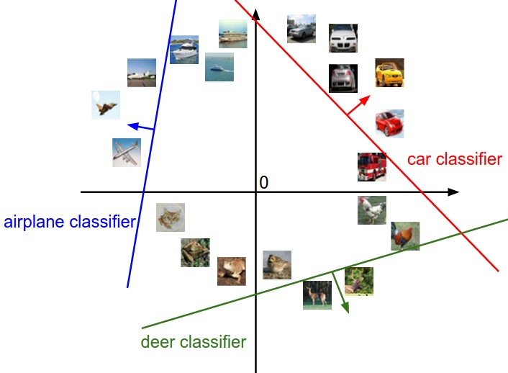
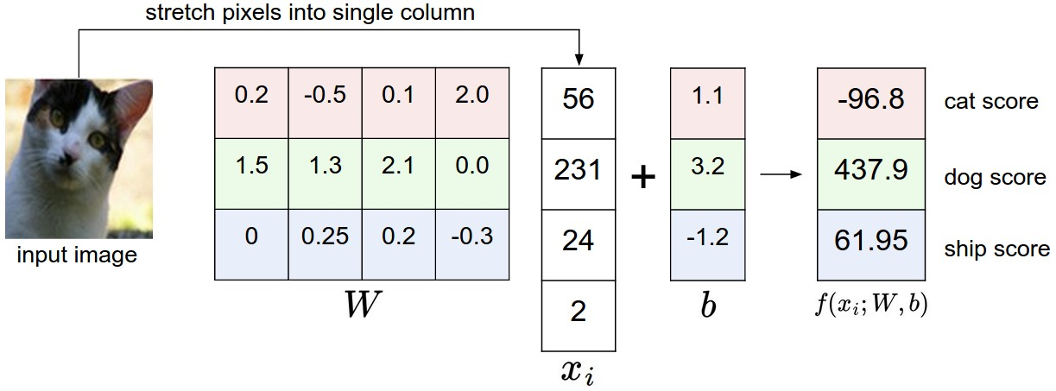
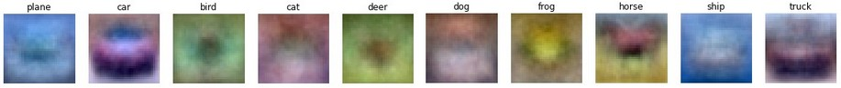
Recall from last time… Linear classifier
image
parameters
10 numbers, indicating class scores
f(x,W)
[32x32x3]
array of numbers 0...1
(3072 numbers total)

Slide 6
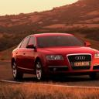
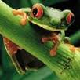
Recall from last time… Going forward: Loss function/Optimization
TODO:
Define a loss function that quantifies our unhappiness with the scores across the training data.
Come up with a way of efficiently finding the parameters that minimize the loss function. (optimization)
-3.45
-8.87
0.09
2.9
4.48
8.02
3.78
1.06
-0.36
-0.72
-0.51
6.04
5.31
-4.22
-4.19
3.58
4.49
-4.37
-2.09
-2.93
3.42
4.64
2.65
5.1
2.64
5.55
-4.34
-1.5
-4.79
6.14

Slide 7
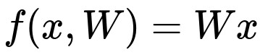
Suppose: 3 training examples, 3 classes.
With some W the scores are:
cat
3.2
1.3
2.2
car
5.1
4.9
2.5
-1.7
2.0
-3.1
frog

Slide 8
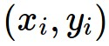
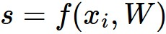

Suppose: 3 training examples, 3 classes.
With some W the scores are:
Multiclass SVM loss:
Given an example
where is the image and
where is the (integer) label,
and using the shorthand for the scores vector:
the SVM loss has the form:
cat
3.2
1.3
2.2
car
5.1
4.9
2.5
-1.7
2.0
-3.1
frog

Slide 9
Suppose: 3 training examples, 3 classes.
With some W the scores are:
Multiclass SVM loss:
Given an example
where is the image and
where is the (integer) label,
and using the shorthand for the scores vector:
the SVM loss has the form:
cat
3.2
1.3
2.2
car
5.1
4.9
2.5
= max(0, 5.1 - 3.2 + 1)
+max(0, -1.7 - 3.2 + 1)
= max(0, 2.9) + max(0, -3.9)
= 2.9 + 0
= 2.9
-1.7
2.0
-3.1
frog
Losses:
2.9

Slide 10
Suppose: 3 training examples, 3 classes.
With some W the scores are:
Multiclass SVM loss:
Given an example
where is the image and
where is the (integer) label,
and using the shorthand for the scores vector:
the SVM loss has the form:
cat
3.2
1.3
2.2
car
5.1
4.9
2.5
= max(0, 1.3 - 4.9 + 1)
+max(0, 2.0 - 4.9 + 1)
= max(0, -2.6) + max(0, -1.9)
= 0 + 0
= 0
-1.7
2.0
-3.1
frog
Losses:
2.9
0

Slide 11
Suppose: 3 training examples, 3 classes.
With some W the scores are:
Multiclass SVM loss:
Given an example
where is the image and
where is the (integer) label,
and using the shorthand for the scores vector:
the SVM loss has the form:
cat
3.2
1.3
2.2
car
5.1
4.9
2.5
= max(0, 2.2 - (-3.1) + 1)
+max(0, 2.5 - (-3.1) + 1)
= max(0, 5.3) + max(0, 5.6)
= 5.3 + 5.6
= 10.9
-1.7
2.0
-3.1
frog
Losses:
2.9
0
10.9

Slide 12
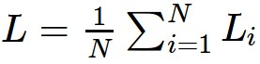
Suppose: 3 training examples, 3 classes.
With some W the scores are:
Multiclass SVM loss:
Given an example
where is the image and
where is the (integer) label,
and using the shorthand for the scores vector:
the SVM loss has the form:
and the full training loss is the mean over all examples in the training data:
cat
3.2
1.3
2.2
car
5.1
4.9
2.5
-1.7
2.0
-3.1
frog
L = (2.9 + 0 + 10.9)/3
= 4.6
Losses:
2.9
0
10.9

Slide 13
Suppose: 3 training examples, 3 classes.
With some W the scores are:
Multiclass SVM loss:
Given an example
where is the image and
where is the (integer) label,
and using the shorthand for the scores vector:
the SVM loss has the form:
Q: what if the sum was instead over all classes?
(including j = y_i)
cat
3.2
1.3
2.2
car
5.1
4.9
2.5
-1.7
2.0
-3.1
frog
Losses:
2.9
0
10.9

Slide 14
Suppose: 3 training examples, 3 classes.
With some W the scores are:
Multiclass SVM loss:
Given an example
where is the image and
where is the (integer) label,
and using the shorthand for the scores vector:
the SVM loss has the form:
Q2: what if we used a mean instead of a sum here?
cat
3.2
1.3
2.2
car
5.1
4.9
2.5
-1.7
2.0
-3.1
frog
Losses:
2.9
0
10.9

Slide 15
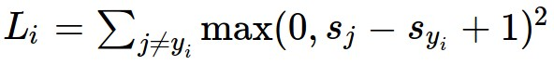
Suppose: 3 training examples, 3 classes.
With some W the scores are:
Multiclass SVM loss:
Given an example
where is the image and
where is the (integer) label,
and using the shorthand for the scores vector:
the SVM loss has the form:
Q3: what if we used
cat
3.2
1.3
2.2
car
5.1
4.9
2.5
-1.7
2.0
-3.1
frog
Losses:
2.9
0
10.9

Slide 16
Suppose: 3 training examples, 3 classes.
With some W the scores are:
Multiclass SVM loss:
Given an example
where is the image and
where is the (integer) label,
and using the shorthand for the scores vector:
the SVM loss has the form:
Q4: what is the min/max possible loss?
cat
3.2
1.3
2.2
car
5.1
4.9
2.5
-1.7
2.0
-3.1
frog
Losses:
2.9
0
10.9

Slide 17
Suppose: 3 training examples, 3 classes.
With some W the scores are:
Multiclass SVM loss:
Given an example
where is the image and
where is the (integer) label,
and using the shorthand for the scores vector:
the SVM loss has the form:
Q5: usually at initialization W are small numbers, so all s ~= 0. What is the loss?
cat
3.2
1.3
2.2
car
5.1
4.9
2.5
-1.7
2.0
-3.1
frog
Losses:
2.9
0
10.9

Slide 18
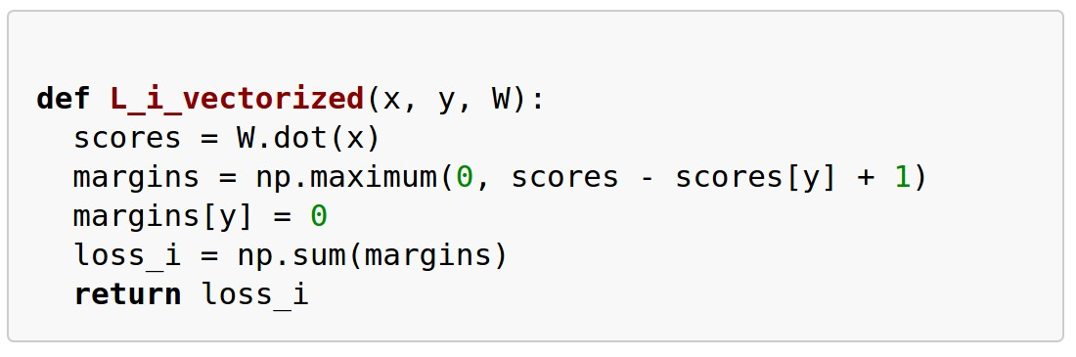
Example numpy code:

Slide 20

There is a bug with the loss:

Slide 21
There is a bug with the loss:
E.g. Suppose that we found a W such that L = 0.
Is this W unique?

Slide 22
Suppose: 3 training examples, 3 classes.
With some W the scores are:
Before:
= max(0, 1.3 - 4.9 + 1)
+max(0, 2.0 - 4.9 + 1)
= max(0, -2.6) + max(0, -1.9)
= 0 + 0
= 0
cat
3.2
1.3
2.2
With W twice as large:
5.1
4.9
2.5
= max(0, 2.6 - 9.8 + 1)
+max(0, 4.0 - 9.8 + 1)
= max(0, -6.2) + max(0, -4.8)
= 0 + 0
= 0
car
-1.7
2.0
-3.1
frog
Losses:
2.9
0

Slide 23
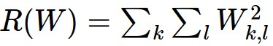
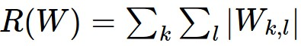
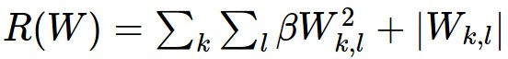
\lambda = regularization strength
(hyperparameter)
Weight Regularization
In common use:
L2 regularization
L1 regularization
Elastic net (L1 + L2)
Max norm regularization (might see later)
Dropout (will see later)

Slide 24
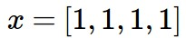
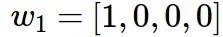
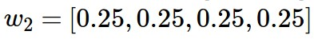
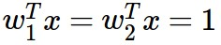
L2 regularization: motivation

Slide 25
Softmax Classifier (Multinomial Logistic Regression)
cat
3.2
car
5.1
-1.7
frog

Slide 26
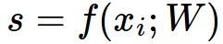
Softmax Classifier (Multinomial Logistic Regression)
scores = unnormalized log probabilities of the classes.
cat
3.2
car
5.1
-1.7
frog

Slide 27
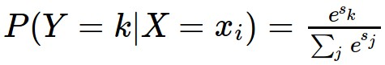
Softmax Classifier (Multinomial Logistic Regression)
scores = unnormalized log probabilities of the classes.
where
cat
3.2
car
5.1
-1.7
frog

Slide 28
Softmax Classifier (Multinomial Logistic Regression)
scores = unnormalized log probabilities of the classes.
where
cat
3.2
Softmax function
car
5.1
-1.7
frog

Slide 29
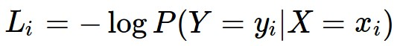
Softmax Classifier (Multinomial Logistic Regression)
scores = unnormalized log probabilities of the classes.
Want to maximize the log likelihood, or (for a loss function)
to minimize the negative log likelihood of the correct class:
where
cat
3.2
car
5.1
-1.7
frog

Slide 30
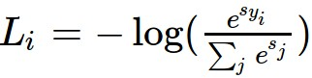
Softmax Classifier (Multinomial Logistic Regression)
scores = unnormalized log probabilities of the classes.
Want to maximize the log likelihood, or (for a loss function)
to minimize the negative log likelihood of the correct class:
where
cat
3.2
car
5.1
-1.7
frog
in summary:

Slide 31
Softmax Classifier (Multinomial Logistic Regression)
cat
3.2
car
5.1
-1.7
frog
unnormalized log probabilities

Slide 32
Softmax Classifier (Multinomial Logistic Regression)
unnormalized probabilities
cat
3.2
24.5
exp
car
5.1
164.0
-1.7
0.18
frog
unnormalized log probabilities

Slide 33
Softmax Classifier (Multinomial Logistic Regression)
unnormalized probabilities
cat
3.2
24.5
0.13
exp
normalize
car
5.1
164.0
0.87
-1.7
0.18
0.00
frog
unnormalized log probabilities
probabilities

Slide 34
Softmax Classifier (Multinomial Logistic Regression)
unnormalized probabilities
cat
3.2
24.5
0.13
L_i = -log(0.13)
= 0.89
exp
normalize
car
5.1
164.0
0.87
-1.7
0.18
0.00
frog
unnormalized log probabilities
probabilities

Slide 35
Softmax Classifier (Multinomial Logistic Regression)
Q: What is the min/max possible loss L_i?
unnormalized probabilities
cat
3.2
24.5
0.13
L_i = -log(0.13)
= 0.89
exp
normalize
car
5.1
164.0
0.87
-1.7
0.18
0.00
frog
unnormalized log probabilities
probabilities

Slide 36
Softmax Classifier (Multinomial Logistic Regression)
Q5: usually at initialization W are small numbers, so all s ~= 0. What is the loss?
unnormalized probabilities
cat
3.2
24.5
0.13
L_i = -log(0.13)
= 0.89
exp
normalize
car
5.1
164.0
0.87
-1.7
0.18
0.00
frog
unnormalized log probabilities
probabilities

Slide 37
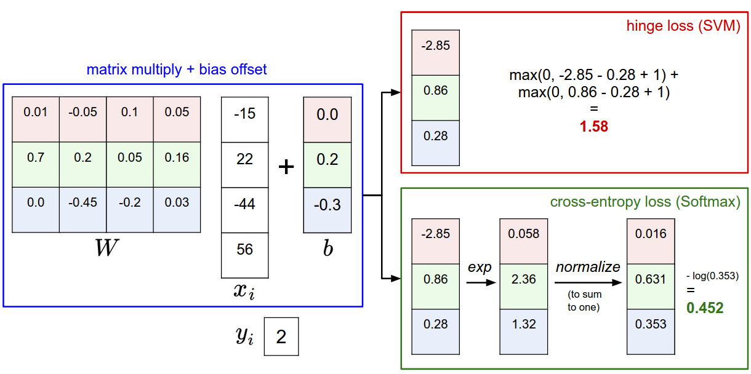

Slide 38
Softmax vs. SVM

Slide 39
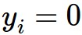
Softmax vs. SVM
assume scores:
[10, -2, 3]
[10, 9, 9]
[10, -100, -100]
and
Q: Suppose I take a datapoint and I jiggle a bit (changing its score slightly). What happens to the loss in both cases?

Slide 40
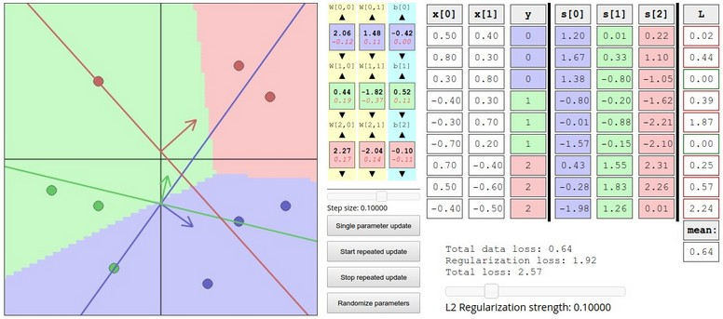
Interactive Web Demo time....
http://vision.stanford.edu/teaching/cs231n/linear-classify-demo/

Slide 41
Optimization

Slide 42
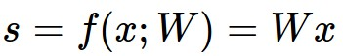
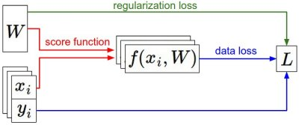
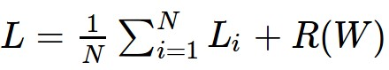
Recap
We have some dataset of (x,y)
We have a score function:
We have a loss function:
e.g.
Softmax
SVM
Full loss

Slide 43
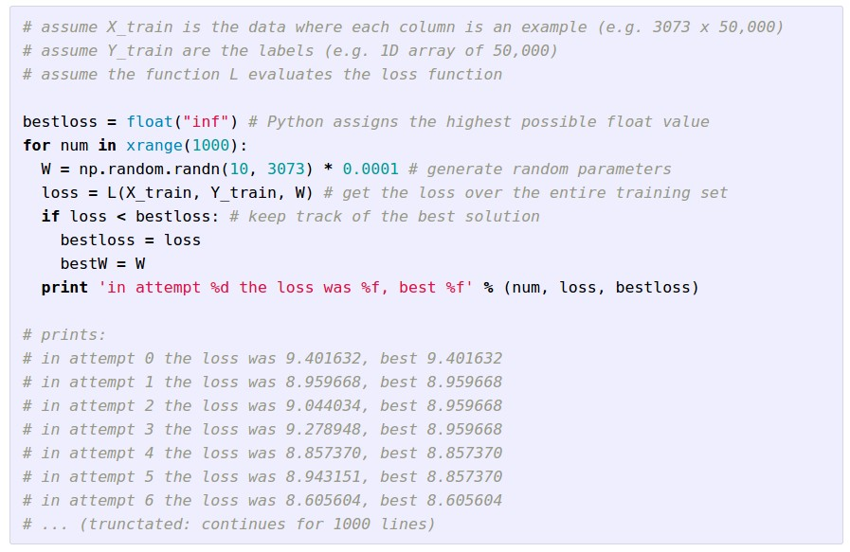
Strategy #1: A first very bad idea solution: Random search

Slide 44
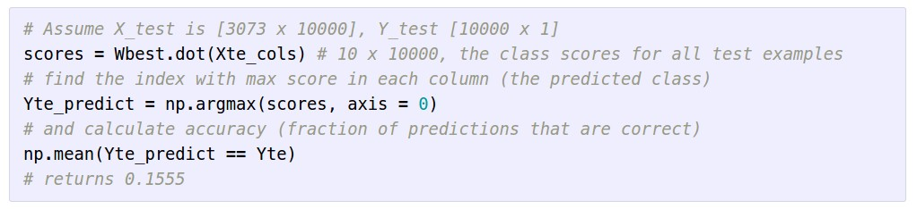
Lets see how well this works on the test set...
15.5% accuracy! not bad!
(SOTA is ~95%)

Slide 45
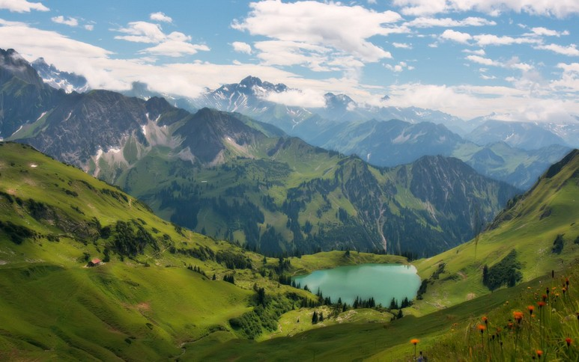

Slide 46


Slide 47
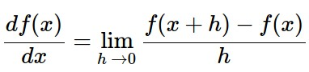
Strategy #2: Follow the slope
In 1-dimension, the derivative of a function:
In multiple dimensions, the gradient is the vector of (partial derivatives).

Slide 48
current W:
[0.34,
-1.11,
0.78,
0.12,
0.55,
2.81,
-3.1,
-1.5,
0.33,…]
loss 1.25347
gradient dW:
[?,
?,
?,
?,
?,
?,
?,
?,
?,…]

Slide 49
current W:
[0.34,
-1.11,
0.78,
0.12,
0.55,
2.81,
-3.1,
-1.5,
0.33,…]
loss 1.25347
W + h (first dim):
[0.34 + 0.0001,
-1.11,
0.78,
0.12,
0.55,
2.81,
-3.1,
-1.5,
0.33,…]
loss 1.25322
gradient dW:
[?,
?,
?,
?,
?,
?,
?,
?,
?,…]

Slide 50
current W:
[0.34,
-1.11,
0.78,
0.12,
0.55,
2.81,
-3.1,
-1.5,
0.33,…]
loss 1.25347
W + h (first dim):
[0.34 + 0.0001,
-1.11,
0.78,
0.12,
0.55,
2.81,
-3.1,
-1.5,
0.33,…]
loss 1.25322
gradient dW:
[-2.5,
?,
?,
?,
?,
?,
?,
?,
?,…]
(1.25322 - 1.25347)/0.0001
= -2.5

Slide 51
current W:
[0.34,
-1.11,
0.78,
0.12,
0.55,
2.81,
-3.1,
-1.5,
0.33,…]
loss 1.25347
W + h (second dim):
[0.34,
-1.11 + 0.0001,
0.78,
0.12,
0.55,
2.81,
-3.1,
-1.5,
0.33,…]
loss 1.25353
gradient dW:
[-2.5,
?,
?,
?,
?,
?,
?,
?,
?,…]

Slide 52
current W:
[0.34,
-1.11,
0.78,
0.12,
0.55,
2.81,
-3.1,
-1.5,
0.33,…]
loss 1.25347
W + h (second dim):
[0.34,
-1.11 + 0.0001,
0.78,
0.12,
0.55,
2.81,
-3.1,
-1.5,
0.33,…]
loss 1.25353
gradient dW:
[-2.5,
0.6,
?,
?,
?,
?,
?,
?,
?,…]
(1.25353 - 1.25347)/0.0001
= 0.6

Slide 53
current W:
[0.34,
-1.11,
0.78,
0.12,
0.55,
2.81,
-3.1,
-1.5,
0.33,…]
loss 1.25347
W + h (third dim):
[0.34,
-1.11,
0.78 + 0.0001,
0.12,
0.55,
2.81,
-3.1,
-1.5,
0.33,…]
loss 1.25347
gradient dW:
[-2.5,
0.6,
?,
?,
?,
?,
?,
?,
?,…]

Slide 54
current W:
[0.34,
-1.11,
0.78,
0.12,
0.55,
2.81,
-3.1,
-1.5,
0.33,…]
loss 1.25347
W + h (third dim):
[0.34,
-1.11,
0.78 + 0.0001,
0.12,
0.55,
2.81,
-3.1,
-1.5,
0.33,…]
loss 1.25347
gradient dW:
[-2.5,
0.6,
0,
?,
?,
?,
?,
?,
?,…]
(1.25347 - 1.25347)/0.0001
= 0

Slide 55
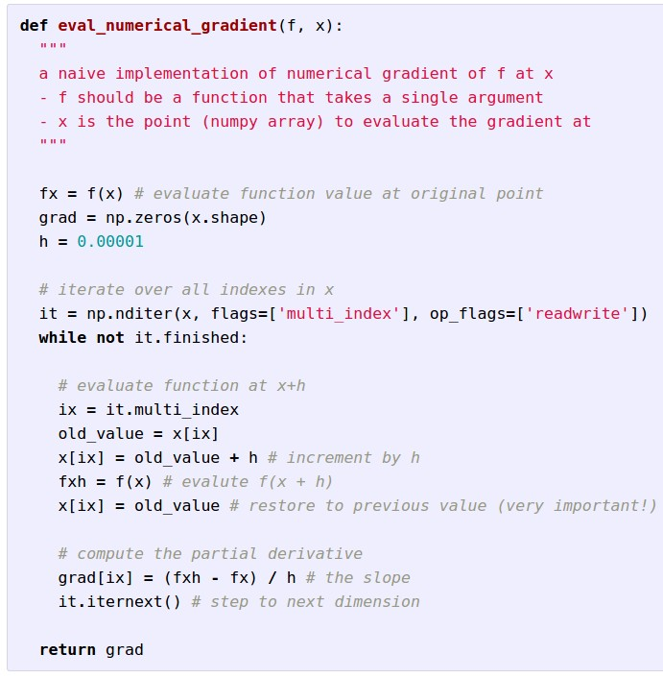
Evaluation the
gradient numerically

Slide 56
Evaluation the
gradient numerically
approximate
very slow to evaluate

Slide 57
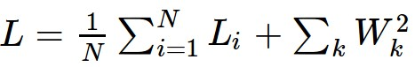
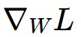
This is silly. The loss is just a function of W:
want

Slide 58
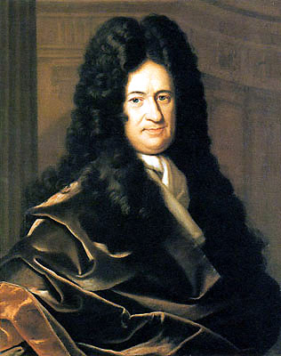
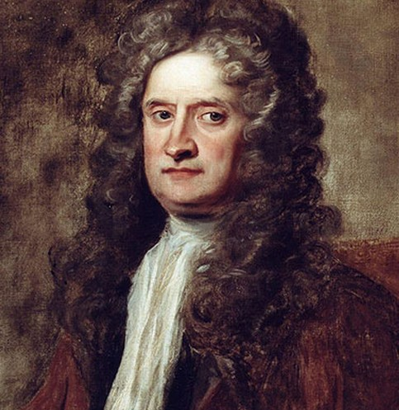
This is silly. The loss is just a function of W:
want

Slide 59

This is silly. The loss is just a function of W:
want
Calculus

Slide 60
This is silly. The loss is just a function of W:
= ...

Slide 61
current W:
[0.34,
-1.11,
0.78,
0.12,
0.55,
2.81,
-3.1,
-1.5,
0.33,…]
loss 1.25347
gradient dW:
[-2.5,
0.6,
0,
0.2,
0.7,
-0.5,
1.1,
1.3,
-2.1,…]
dW = ...
(some function data and W)

Slide 62
In summary:
Numerical gradient: approximate, slow, easy to write
Analytic gradient: exact, fast, error-prone
=>
In practice: Always use analytic gradient, but check implementation with numerical gradient. This is called a gradient check.

Slide 63

Gradient Descent

Slide 64

W_2
original W
W_1
negative gradient direction

Slide 65

Mini-batch Gradient Descent
only use a small portion of the training set to compute the gradient.
Common mini-batch sizes are 32/64/128 examples
e.g. Krizhevsky ILSVRC ConvNet used 256 examples

Slide 66

Example of optimization progress while training a neural network.
(Loss over mini-batches goes down over time.)

Slide 67

The effects of step size (or “learning rate”)

Slide 68
Mini-batch Gradient Descent
only use a small portion of the training set to compute the gradient.
we will look at more fancy update formulas
(momentum, Adagrad, RMSProp, Adam, …)
Common mini-batch sizes are 32/64/128 examples
e.g. Krizhevsky ILSVRC ConvNet used 256 examples

Slide 69

The effects of different update form formulas
(image credits to Alec Radford)

Slide 70




Aside: Image Features

Slide 71


Example: Color (Hue) Histogram
hue bins
+1

Slide 72


Example: HOG/SIFT features
8x8 pixel region,
quantize the edge orientation into 9 bins
(image from vlfeat.org)

Slide 73
Example: HOG/SIFT features
8x8 pixel region,
quantize the edge orientation into 9 bins
Many more:
GIST, LBP, Texton, SSIM, ...
(image from vlfeat.org)

Slide 74






Example: Bag of Words
histogram of visual words
visual word vectors
learn k-means centroids
“vocabulary” of visual words
1000-d vector
144
1000-d vector
1000-d vector
e.g. 1000 centroids

Slide 75

vector describing various image statistics
f
Feature Extraction
10 numbers, indicating class scores
training
[32x32x3]
f
10 numbers, indicating class scores
training
[32x32x3]

Slide 76
Next class:
Becoming a backprop ninja
and
Neural Networks (part 1)

